Slide 1
Today’s topic: energy
Directions:
Pick up a class work packet.
Bags off and underneath your chair
Winter Packets out on your desk.
Begin your Do Now Immediately,
Independently and Silently.
Monday 3rd January, 2011

Slide 2
Do No Review
WELCOME BACK…AND HAPPY NEW YEAR.

Slide 3
What Are We Doing, Today?
BZs to top 5 students earning points:
Character focus is: GRIT and SELF CONTROL
- student stays on task
- student is engaged in the lesson and raises hand to ask/answer/read questions
- student follows directions the first time.

Slide 4
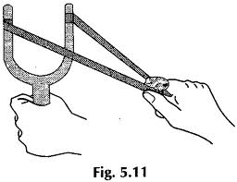
ACTIVATING PRIOR KNOWLEDGE
QT: have you ever seen or used a sling shot?
Study the diagram below of a pulled sling shot.
1. What do you think will happen to the object when the sling is released?
2. Why?

Slide 5
NOTES: WHAT IS ENERGY?
Energy makes change possible. We use it to do things for us. It moves cars along the road and boats over the water. It bakes a cake in the oven and keeps ice frozen in the freezer. It plays our favorite songs on the radio and lights our homes. Energy is needed for our bodies to grow and it allows our minds to think.

Slide 6
Definition: Energy
ENERGY IS THE ABILITY TO MAKE SOMETHING HAPPEN.
Energy is in everything. We use energy for everything we do, from making a jump shot to baking cookies to sending astronauts into space.
Energy comes in different forms in
the world:
Heat (thermal)
Light (radiant)
Motion (kinetic)*
Electrical
Chemical*
Potential Energy*
Nuclear energy
Gravitational

Slide 7
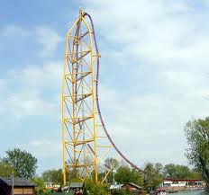
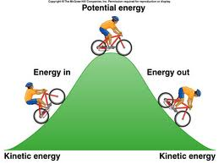
TWO MAIN TYPES OF ENERGY…
There are two main types of energy:
1. Potential (stored) energy
2. Kinetic (motion) energy

Slide 8
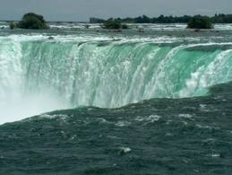
Potential Energy is stored energy
POTENTIAL ENERGY IS STORED ENERGY.
Potential energy is the energy something has by reason of its position or state. With regards to position, potential energy increases with increase in weight and height.
An example of the potential energy a body has by reason of its state is A WOUND UP TOY OR SPRING.
An example of the potential energy a body has by reason of its position is WATER BEHIND A DAM OR TOP OF A WATER FALL.

Slide 9
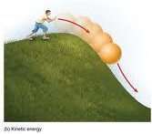
KINETIC ENERGY IS ENERGY OF MOTION
KINETIC ENERGY IS ENERGY OF MOTION
Kinetic energy is the energy which something has because of its motion.
An obvious example of kinetic energy is MOVING BULLETS. This is able to do work because it changes the state of something when it strikes it.

Slide 10
Think Aloud #1: comparing and contrasting potential with kinetic energy
Complete the table below to compare which one of the activities is potential or kinetic or both types of energy. Explain your answer.
Explain your answer:
Because the wave is moving downwards toward the beach. Kinetic energy is involved when anything is moving.
Activity | Potential Energy | Kinetic Energy | Both
Waves crashing on a beach |  | x

Slide 11
Guided Practice: comparing kinetic and potential energy
1. Circle the correct answer to complete the definition of the following:
Energy is the:
Ans: C
2. a. potential energy is stored energy that something has because of position or state.
i. e.g anything above ground level
b. kinetic energy is energy of motion
i. e.g anything moving

